Slide 1
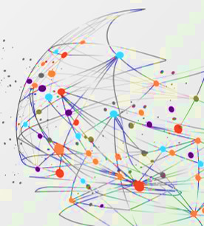
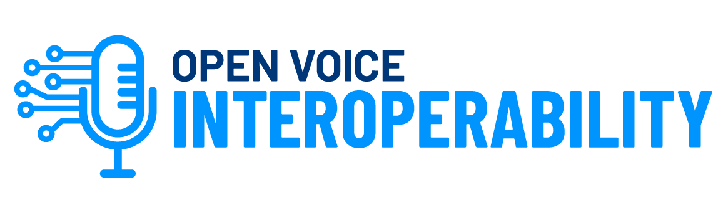
Conversational GenAI Systems and Interoperable Assistants
Conversational GenAI Workshop August 8, 2024 New York City
Diego Gosmar, XCALLY
Deborah Dahl, Conversational Technologies
Olga Howard, PBS
Emmett Coin, ejTalk
Linux Foundation AI & Data Foundation, Open Voice Interoperability Initiative

Slide 2




Thanks to our sponsors!

Slide 3
Today’s Agenda
9:30 AM
Introductory: Welcome • About the LFAI & Data Foundation, our project • What are conversational Assistants? • Why do we need Interoperability? Instructor: Deborah Dahl, Conversational Technologies, Head of OVON Interoperability initiative
10:00 AM
Technologies: LLMs Key Concepts and Embedding • Retrieval Augmented Generation for AI • Use Cases • Hands-on examples Instructor: Diego Gosmar OVON Ambassador, Chief AI Officer XCALLY.ai
12:00 PM
Lunch
1:00 PM
Generative Conversational AI interoperability use cases at scale: Case Study--PBS Discovery use case design Instructor: Olga Howard, PBS
2:00 PM
Diving into the OVON Sandbox: Overview of the OVON specifications • Designing a GenAI based interoperable assistant with the OVON sandbox • Hands on with the Sandbox using the result of the previous design exercise Instructor: Emmett Coin, ejTalk
4:30 PM
Discussions/Conclusions (All)

Slide 4


Slide 5
What is LF AI & Data?
LF AI & Data is an umbrella foundation of the Linux Foundation that supports open source innovation in artificial intelligence (AI) and data. LF AI & Data was created to support open source AI and data, and to create a sustainable open source AI and data ecosystem that makes it easy to create AI and data products and services using open source technologies.

Slide 6
Mission
A neutral home, combined with a fair, open and transparent technical governance model for open source projects enables growth in participating organizations and contributors.

Slide 7

67
199+ M
331+ K
2,920+
100K +
Contributors
9
420M
420M
420M
Projects
LoC
Commits
Organizations
Technical WGs

Slide 8
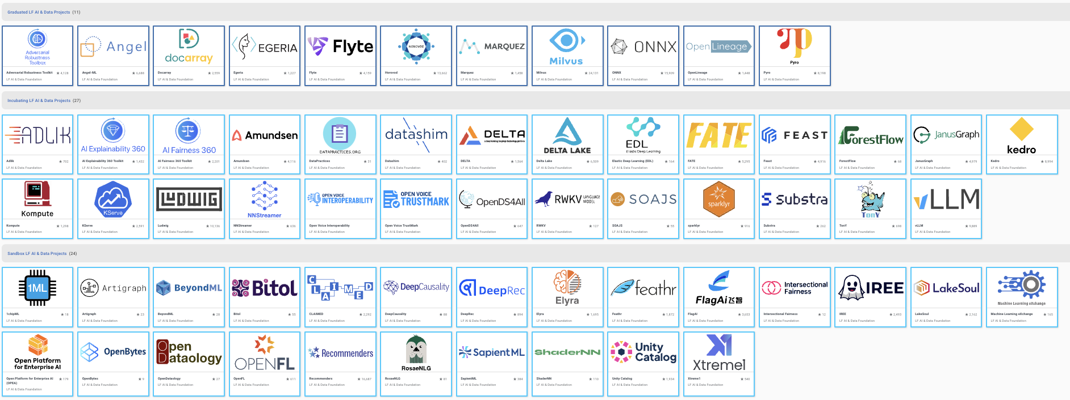
Projects Hosted in LF AI & Data

Slide 9
About the Interoperability Initiative
Following on from the Open Voice Network
A project of the LF AI & Data Foundation since 2023
Aims to revolutionize the conversational AI landscape by enabling voice and conversational AI systems to function like the web
Proposes a future where users can seamlessly interact with any assistant or language model
The API under development will allow assistants to interoperate across platforms, enabling seamless communication and content transfer

Slide 10
What are Conversational Assistants?
Software systems that interact with users using natural language in the form of speech or text
Like other software, they can perform many functions
Answer questions
Store information
Provide entertainment
Control the physical environment
But the difference is that with conversational assistants, users and systems interact with natural language

Slide 11
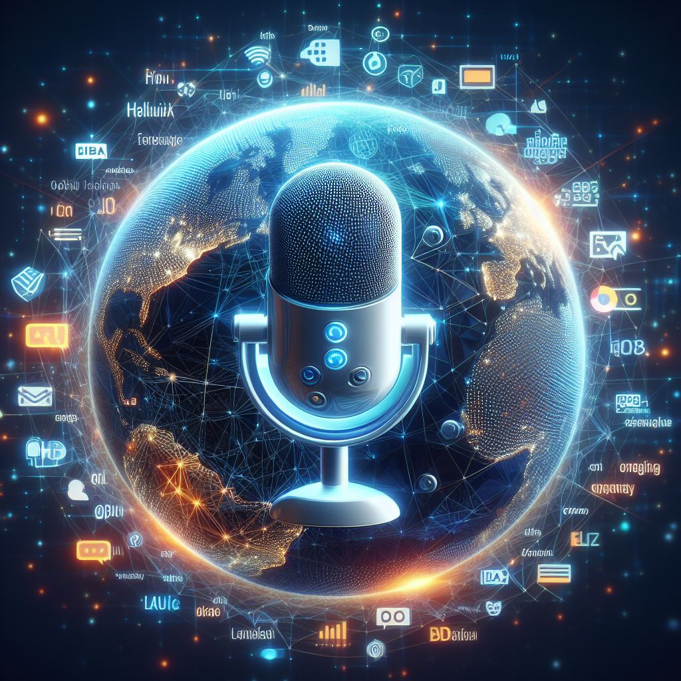
Collaboration among Intelligent Assistants
There are millions of chatbots and voice bots (conversational assistants) in the world
Hosted on mobile phones, smart speakers and websites
Hosted by many organizations – government, business, and non-profit
Each one is independent of the others, even within an organization
Each one has its own expertise
This leads to:
implementation complexity
duplication of effort
friction for users

Slide 12
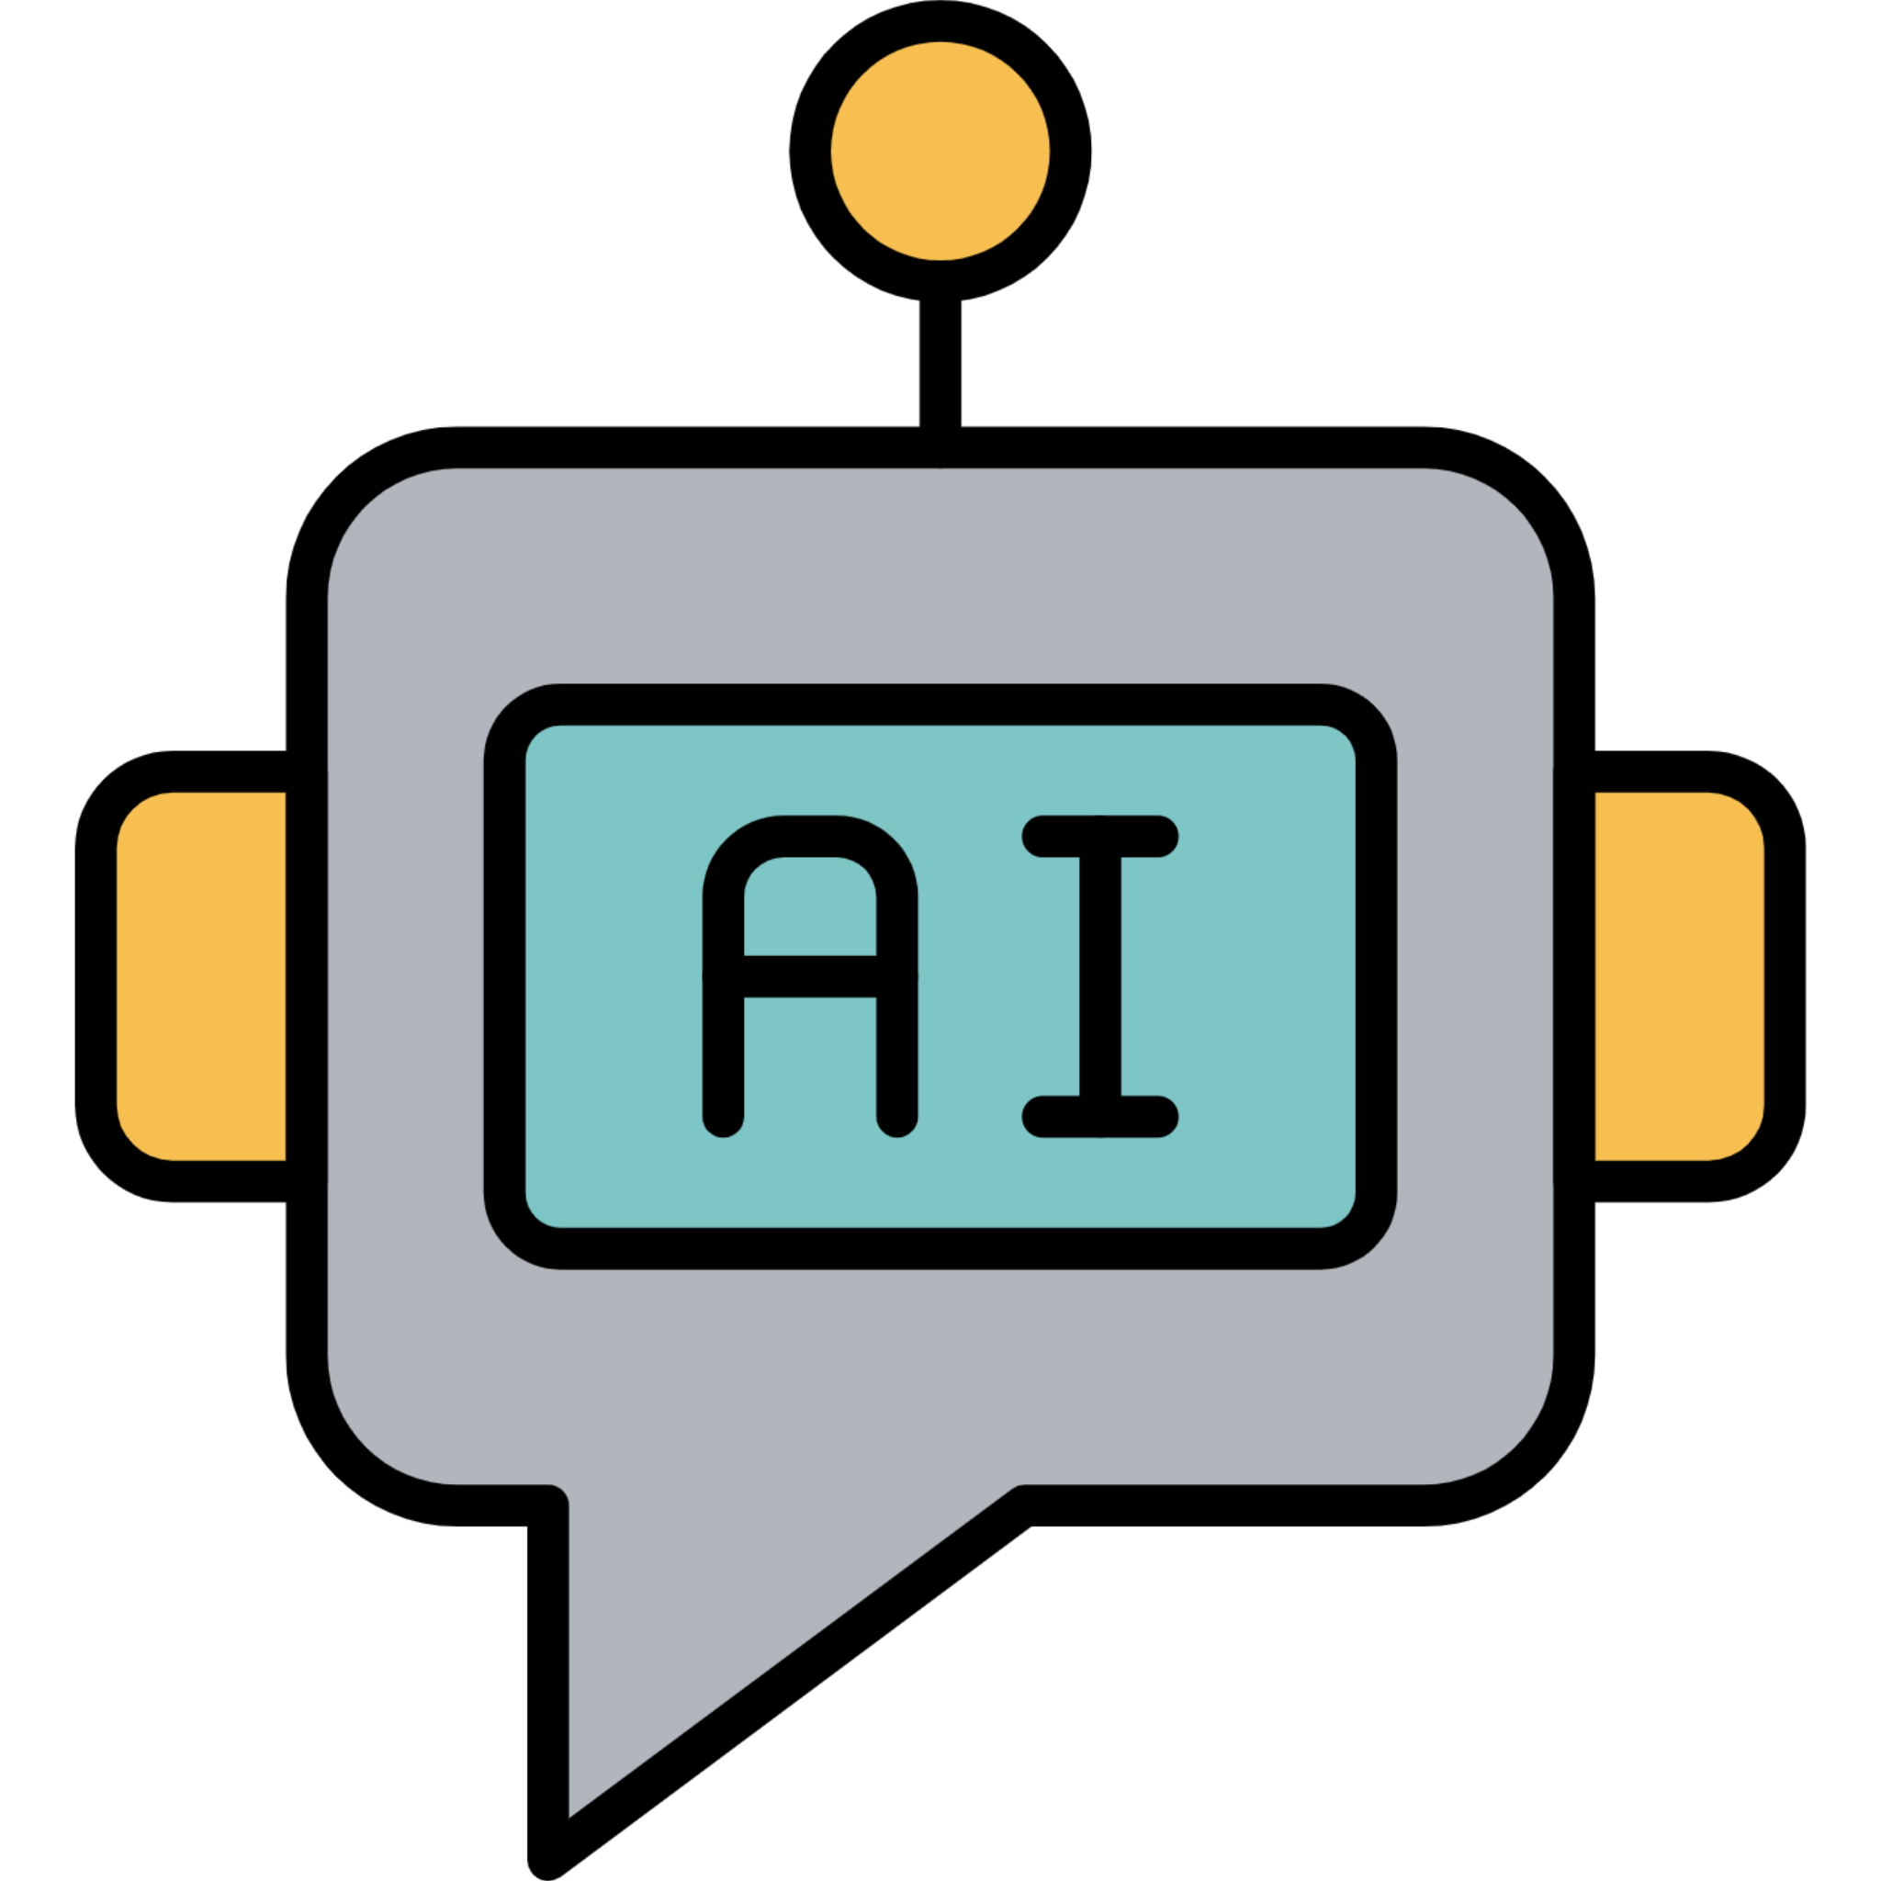




Local store
Drugstore chain
Drug information site
IoT devices, Lights, cameras, HVAC
My prescriptions
Robot pets
Public robots (stores, airports, museum)
Interoperable Intelligent Conversational Assistants
Notes:
Personal robot, for example for eldercare. With AI natural language interface users are already a long way toward knowing how to control the device

Slide 13

Open Voice Interoperability Standards
Open source
Dynamic, real-time configurations of AIs
Standard messages
Few assumptions about assistant architecture and capabilities
Resources: implementation sandbox and specs in our GitHub repositories https://github.com/open-voice-interoperability

Slide 14
Topic 1: GenAI Technologies
Presented by Diego Gosmar
Large Language Models (LLMs): Key Concepts and Embedding
Retrieval Augmented Generation for AI (RAG)
XCALLY and SmartLibrary demos with OVON specs

Slide 15
Topic 2: Use cases for Generative Conversational AI interoperability
Presented by Olga Howard, the first afternoon topic

Slide 16
Topic 3: The Open Voice Sandbox
Presented by Emmett Coin
A browser/assistant system for experimentation with OVON Envelopes. It is:
Text and Speech based
Provides a server to run as localhost to host the browser html/javascript
Has a list of OVON Envelope based assistant servers to play with
Has a skeleton python assistant server that you can use to build assistants
https://github.com/open-voice-interoperability/open-voice-sandbox

Slide 17
Types of Open Voice Messages
Assistant Manifest – how an assistant describes its capabilities
Conversation Envelope – make connections, exchange information, end interactions
Dialog Events– represent natural language utterances from user and system

Slide 18
Conclusions, Summary, Next Steps
Use case exercise was valuable
How can average person use LLM’s to improve their lives?
Can we use these technologies to mitigate social issues like aging population?
Assistants have been siloed by big players who don’t want open specs, how to overcome that roadblock?
How to get momentum for wider adoption?
20,000 bots running on Telegram
Need to discuss security of automation
Analog of Google Search for bots?
Potential “action” eventType?

Slide 19

What you can do
Try out our interoperability specs, using the sandbox or starting from scratch
Give us feedback on your experiences
Join us as we continue to define our specs!

Slide 20


More information
https://github.com/open-voice-interoperability
Generated with AI ∙ March 22, 2024 at 4:18 PM

